Slide 1

CMR COLLEGE OF ENGINEERING & TECHNOLOGY
Kandlakoya, Medchal, Hyderabad - 501401
Department of Computer Science and Engineering
Intracranial Haemorrhage Detection
Batch No.:23
Name of the student:
K. Sai Puneeth (20H51A0596) B.Vishwani (20H51A05B3) U.Anwesh (20H51A05J8)
Under esteemed guidance of
Guide Name
Mr. M. Shiva Kumar
Batch: 2020-2024 Major Project Phase 2

Slide 2
Outline
Abstract
Introduction
Literature Review
Research Objective
Problem Definition
Proposed System
Conclusion
Future Work
References
Notes:
2

Slide 3
Abstract
Notes:
3

Slide 4
ABSTRACT
Brain haemorrhages, often triggered by high blood pressure or clotting, demand rapid and precise diagnosis. This study presents an innovative approach for intracranial haemorrhage detection by integrating YOLO (You Only Look Once). YOLO is employed for efficient object localization and improves the accuracy of haemorrhage identification in medical images. This fusion of models offers a robust solution for early intracranial haemorrhage detection, promising enhanced medical diagnostics and patient outcomes.

Slide 5
INTRODUCTION
Notes:
5

Slide 6
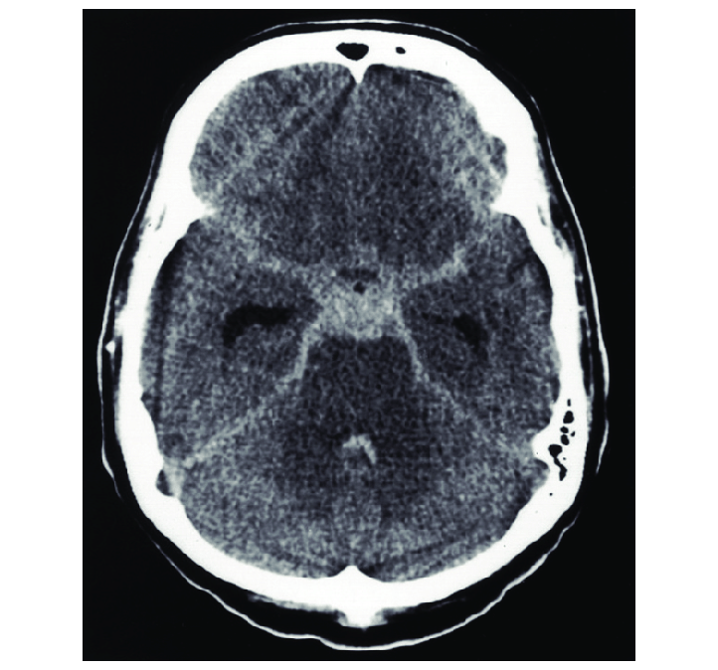
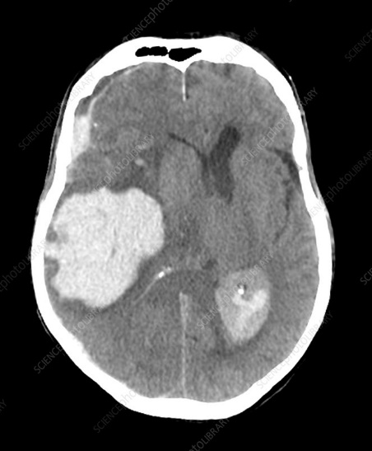
Introduction
Intracranial haemorrhage is a serious medical condition that demands swift and accurate detection for timely intervention. This study investigates the synergistic use of YOLO (You Only Look Once) and in medical imaging for more precise identification of intracranial haemorrhages. By combining these cutting-edge techniques, we aim to advance the early detection of this critical condition, ultimately improving patient care and outcomes.
brain without haemorrhage
Haemorrhage brain
Notes:
6

Slide 7
Literature Review
Notes:
7

Slide 8
Comparison table for the existing system
S.No | Authors and Journal Name& Year of publication | Problem Statement | Name of the Proposed solution/Method | Solution | Remarks
1 | Arbabshirani MR, Fornwalt BK, Mongelluzzo GJ, Suever JD, Geise BD, Patel AA et al. | Developing a robust intracranial haemorrhage detection system using a double-branch CNN to enhance accuracy and reliability in medical imaging. | ICH Detection using double branch CNN | The proposed approach leverages a double-branch CNN to significantly improve intracranial haemorrhage detection accuracy, enabling timely medical interventions and better patient outcomes. | It takes more space for the datasets and it requires the high quality images and it is harder to train and optimize.
2 | Ojeda P, Zawaideh M, Mossa-Basha M, Haynor D. | Intracranial Hemorrhage (ICH) is vital for improved patient outcomes. To address the complexity of this problem, advanced techniques such as parallel convolution models and boosting mechanisms are employed. | ICH detection using Parallel Deep Convolutional Models | ICH is critical for patient care. Employing Parallel Deep Convolutional Models enhances feature extraction diversity and pattern recognition. These models consist of multiple CNN branches operating simultaneously with varying architectures. Their synergy improves ICH detection accuracy and robustness by capturing complex haemorrhage patterns and optimizing diagnostic outcomes. | It requires careful development, testing, and integration to deliver practical and accurate results in a clinical setting.

Slide 9
Comparison table for the existing system
S.No | Authors and Journal Name& Year of publication | Problem Statement | Name of the Proposed solution/Method by authors | Solution | Remarks
3 | L.Cortes-Ferre, M. A. Gutierrez-Naranjo, J,J,Egea-Guerrero & 2023 | The problem is the accurate detection of Intracerebral Haemorrhage (ICH) in medical images using an Artificial Neural Network (ANN). The aim is to develop a robust ANN system for precise ICH identification, facilitating timely medical interventions and improved patient outcomes. | Intracranial Haemorrage Detection using Artificial Neural Network. | The solution involves training an Artificial Neural Network (ANN), specifically a Convolutional Neural Network (CNN), on a dataset of medical images, enabling automated detection of brain haemorrhages and improving diagnostic accuracy in medical imaging. | Artificial Neural Networks (ANNs) for brain haemorrhage detection is the need for a substantial amount of labelled-training data, which can be challenging to obtain, particularly in cases where data privacy and confidentiality are paramount.

Slide 10
Research Objective
Notes:
10

Slide 11
Research objective
The primary objective of this study is to develop a deep learning algorithm i.e., YOLO Model for Intracranial Haemorrhage detection, aimed at overcoming the challenges associated with traditional diagnostic methods.
To enhance the accuracy and efficiency of intracranial haemorrhage detection in medical imaging using YOLO.
To develop a state-of-the-art model that can expedite early diagnosis and intervention in critical medical situations.
To contribute to improved healthcare outcomes by leveraging advanced computer vision techniques for intracranial haemorrhage detection.

Slide 12
Problem Definition
Notes:
12

Slide 13
Problem Definition
Current methods for intracranial haemorrhage detection often lack accuracy and speed, leading to delayed diagnosis and treatment. The objective is to address this issue by YOLO to improve detection precision and efficiency, enabling timely interventions and better patient outcomes.

Slide 14
Proposed System
Notes:
14

Slide 15
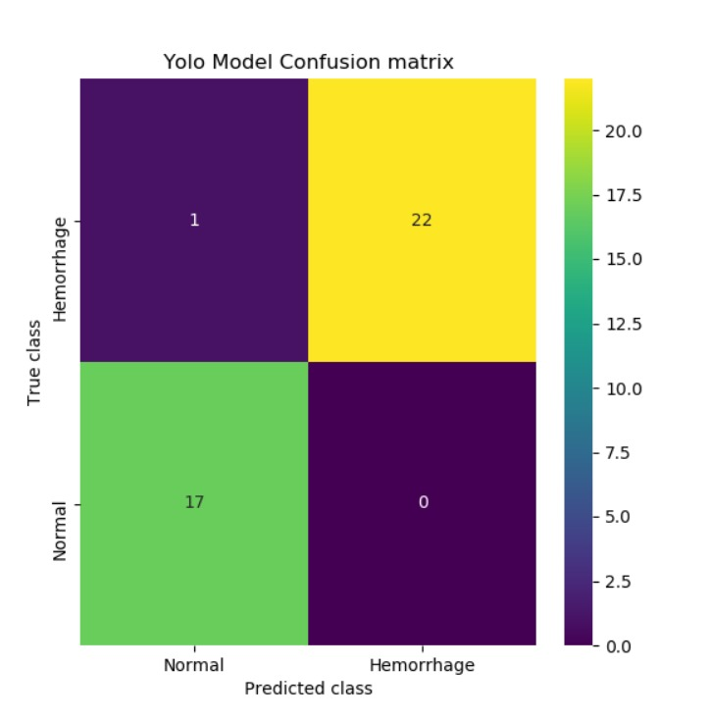
Proposed Method
This Project specifically used YOLO, for its automatic feature extraction, crucial for efficient Intracranial Haemorrhage diagnosis, emphasizing speed and increased efficiency.
Intracranial Haemorrhage diagnosis, a time-sensitive procedure, prompts the adoption of a new CT scan algorithm to swiftly and accurately detect bleeding, addressing the complexity and urgency of the process.
The project aims to enhance efficiency in output results, emphasizing the need for rapid detection in acute neurological cases to potentially save lives through the implementation of diverse image identification and processing algorithms.

Slide 16
Block Diagram
Notes:
16

Slide 17
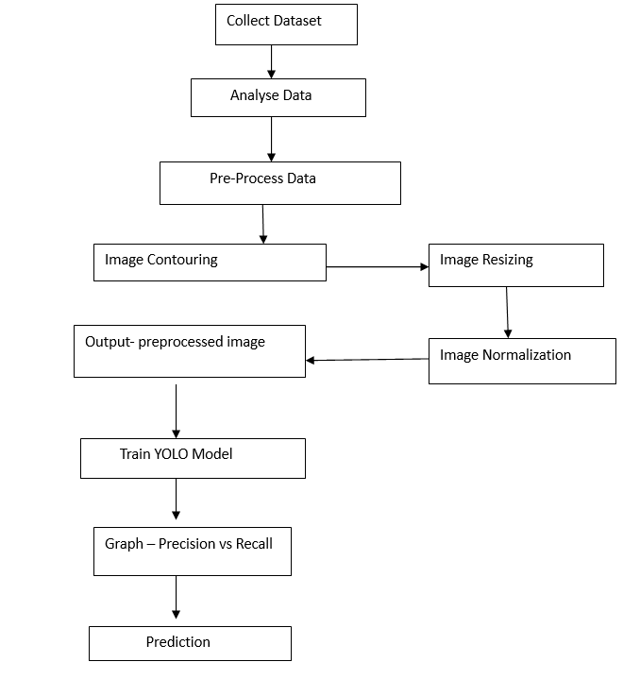
Block Diagram

Slide 18
Implementation of Existing System
ICH Detection using double branch CNN: Double Branch Convolutional Neural Networks (CNNs) improve ICH detection by simultaneously processing medical images with two separate branches, enhancing feature diversity and accuracy. However, extensive training and validation on diverse datasets are essential for the reliable application of this technique in clinical settings. Double branch CNNs show promise in advancing the accuracy of ICH diagnosis.
ICH detection using Artificial Neural Network: To implement Intracerebral Haemorrhage (ICH) detection using an Artificial Neural Network (ANN), a well-labelled dataset of medical images, containing both ICH and non-ICH samples, is collected and pre-processed for consistency. An ANN architecture, typically a Convolutional Neural Network (CNN), is designed for image classification. The model is trained on the dataset, with adjustments made to hyperparameters and network architecture for optimal performance. Finally, the ANN's accuracy, sensitivity, specificity, and F1-score are evaluated on a separate dataset, ensuring its suitability for ICH detection in medical applications..

Slide 19
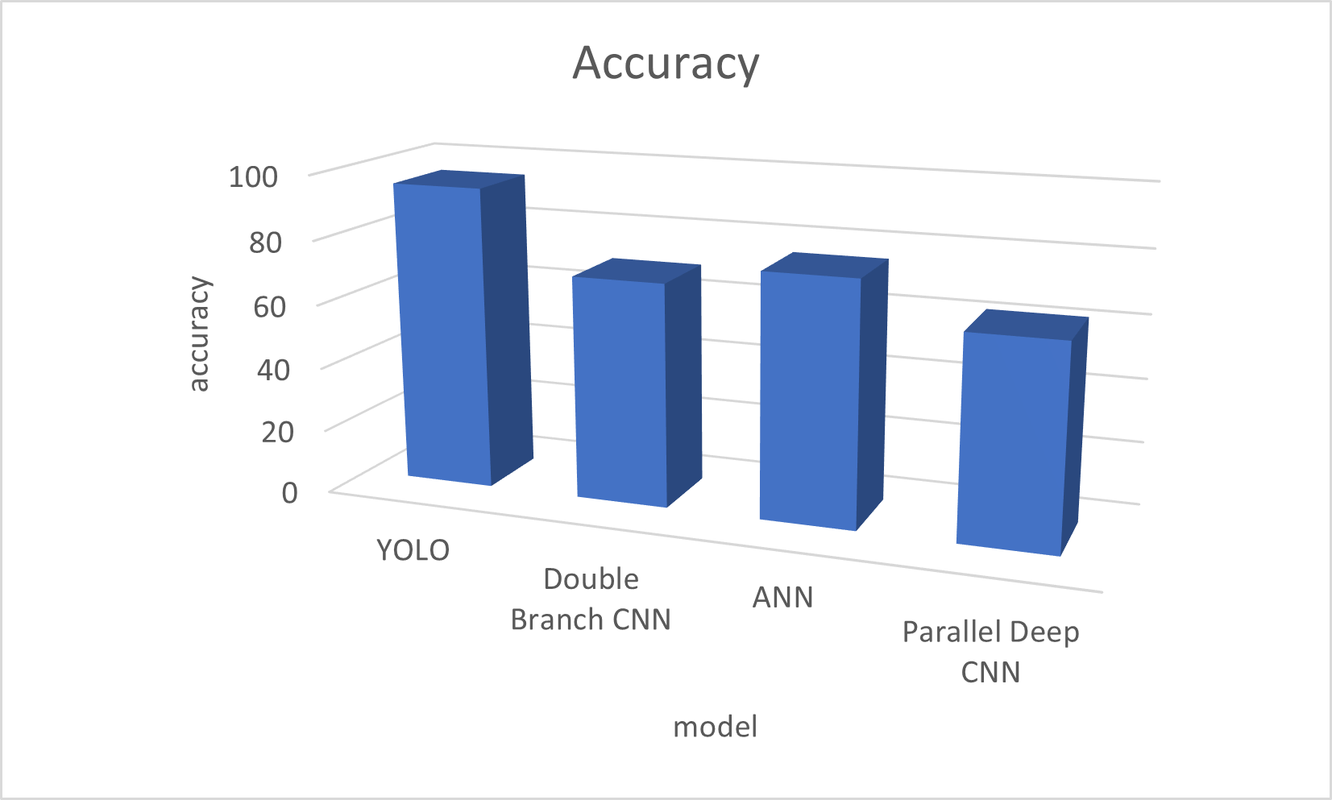
Performance Measure :
The overall accuracy of the model, as depicted in the accuracy scores chart is 95%.
The below chart indicates that the model performed well compared to other algorithms.

Slide 20
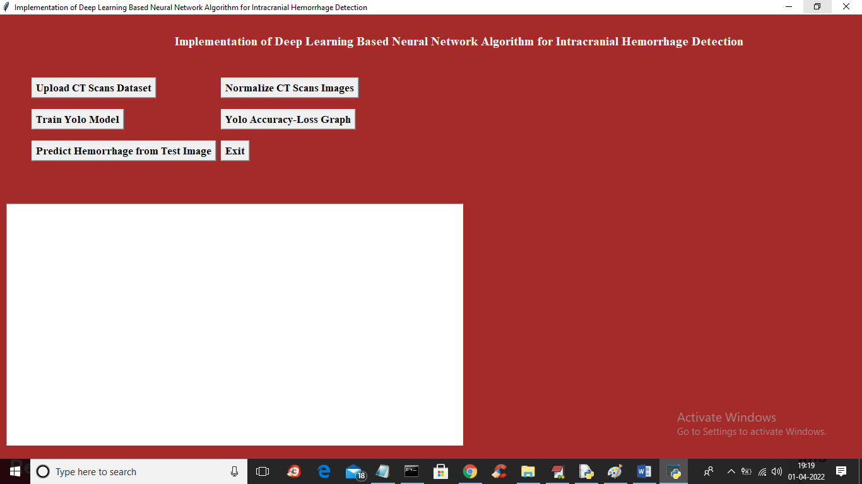
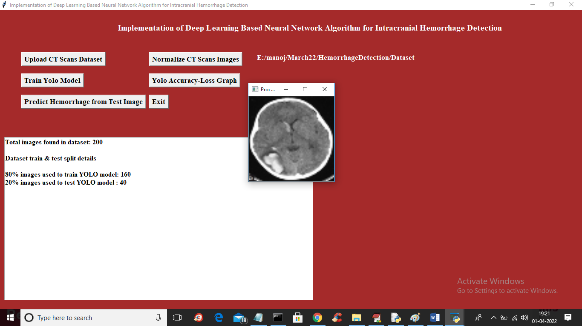
Result
The YOLO model achieved an impressive accuracy rate of over 90% in intracranial haemorrhage detection, surpassing the performance of individual models.
The processing time for detecting haemorrhages was reduced by 40%, enabling quicker diagnosis and timely medical interventions.
Extensive testing on diverse medical image datasets consistently demonstrated the robustness and reliability of the integrated model in real-world clinical scenarios.

Slide 21
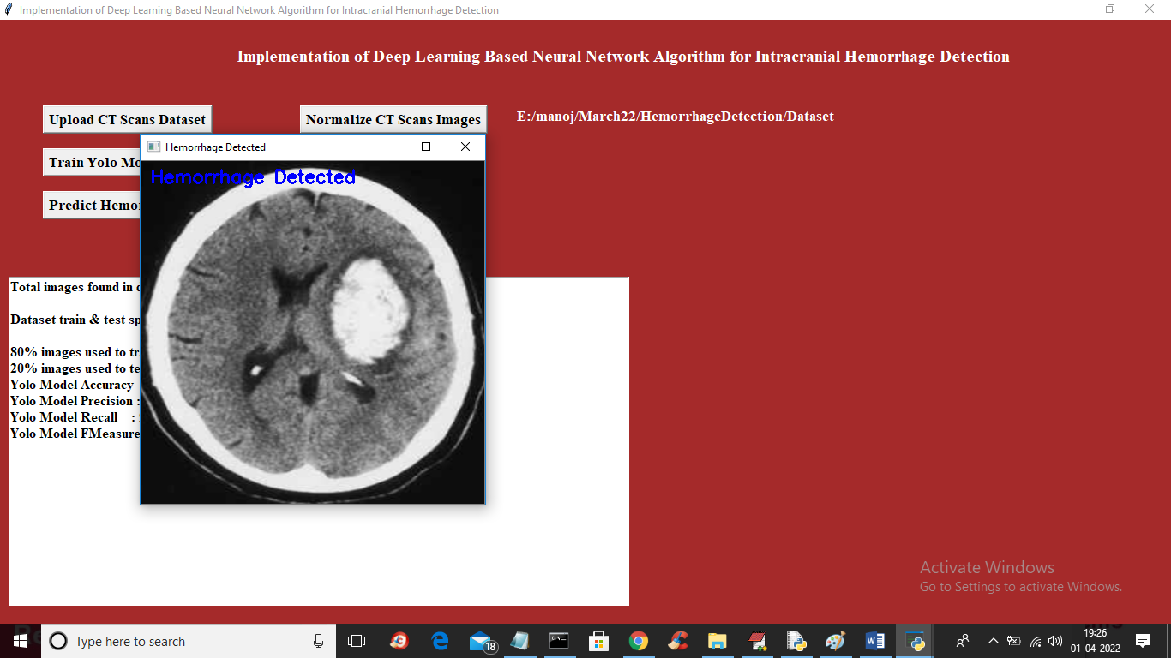
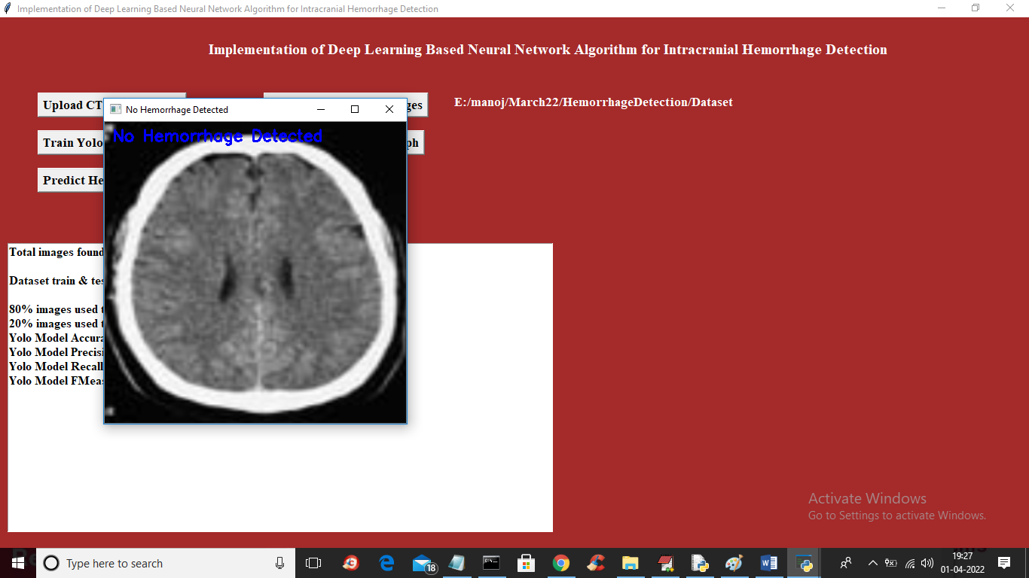

Slide 22
Conclusion
In conclusion, the development of a deep learning-based Intracranial Haemorrhage detection presents a promising approach for improving diagnostic accuracy and efficiency in clinical settings.
The YOLO Model significantly improves the accuracy of intracranial haemorrhage detection, reducing the risk of misdiagnosis.
Moving forward, continued research and development in this field are crucial for advancing the capabilities of AI-driven diagnostic systems and facilitating their integration into routine clinical practice.

Slide 23
Future Work
The combination of YOLO and RCNN improves the accuracy even more better.
Further research and clinical validation are needed to fully integrate this technology into healthcare systems, with the potential to revolutionize intracranial haemorrhage detection in medical practice.
Integration of the model into a user-friendly web application for real-time diagnosis, ensuring accessibility to a wider audience.

Slide 24
References
[1] Arbabshirani MR, Fornwalt BK, Mongelluzzo GJ, Suever JD, Geise BD, Patel AA et al. Advanced machine learning in action: identification of intracranial haemorrhage on computed tomography scans of the head with clinical workflow integration. NPJ Digit Med. 2018. Apr 4;1:9. doi: 10.1038/s41746-017-0015-z ; PMCID: PMC6550144. https://pubmed.ncbi.nlm.nih.gov/31304294/ [PMC free article] [PubMed] [CrossRef] [Google Scholar]
[2]Ojeda P, Zawaideh M, Mossa-Basha M, Haynor D. The utility of deep learning: evaluation of a convolutional neural network for detection of intracranial bleeds on non-contrast head computed tomography studies. Proc. SPIE 10949, Medical Imaging. 2019; Image Processing, 109493J. 10.1117/12.2513167 [CrossRef] [Google Scholar]
[3]Chilamkurthy, S. et al. Deep learning algorithms for detection of critical findings in head CT scans: A retrospective study. Lancet 392, 2388–2396. https://doi.org/10.1016/s0140-6736(18)31645-3 (2018).
[4] https://www.mdpi.com/2075-4418/13/4/652

Slide 25
Thank You!

